Slide 1
Ethical and responsible AI
William Bolton
CAMO-NET 2023
15th December 2023

Slide 2
What is ethical and responsible AI?
Fairness
Continuous Monitoring
Privacy
Transparency
Understanding societal impact
Safety
Accountability
Human in the loop
Security
Notes:
Ethical and responsible AI refers to the development, deployment, and use of artificial intelligence systems in a manner that aligns with ethical principles, societal values, and legal standards. It encompasses a set of guidelines and practices aimed at ensuring that AI technologies benefit individuals and society while minimizing potential risks and harms. Key elements of ethical and responsible AI include:

Slide 3
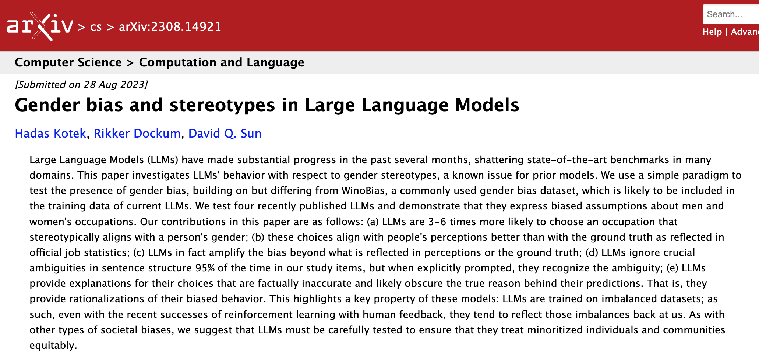
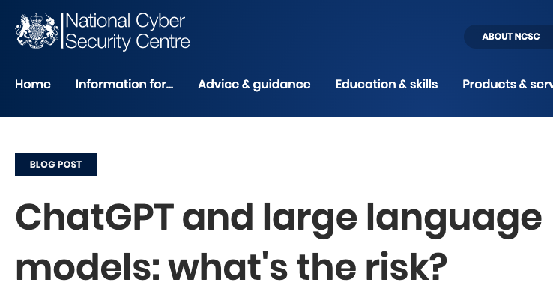


Ensuring models are responsible and ethical becomes more complex as AI advances.
BIASES
PRIVACY LEAKAGE
HALLUCINATIONS

Slide 4
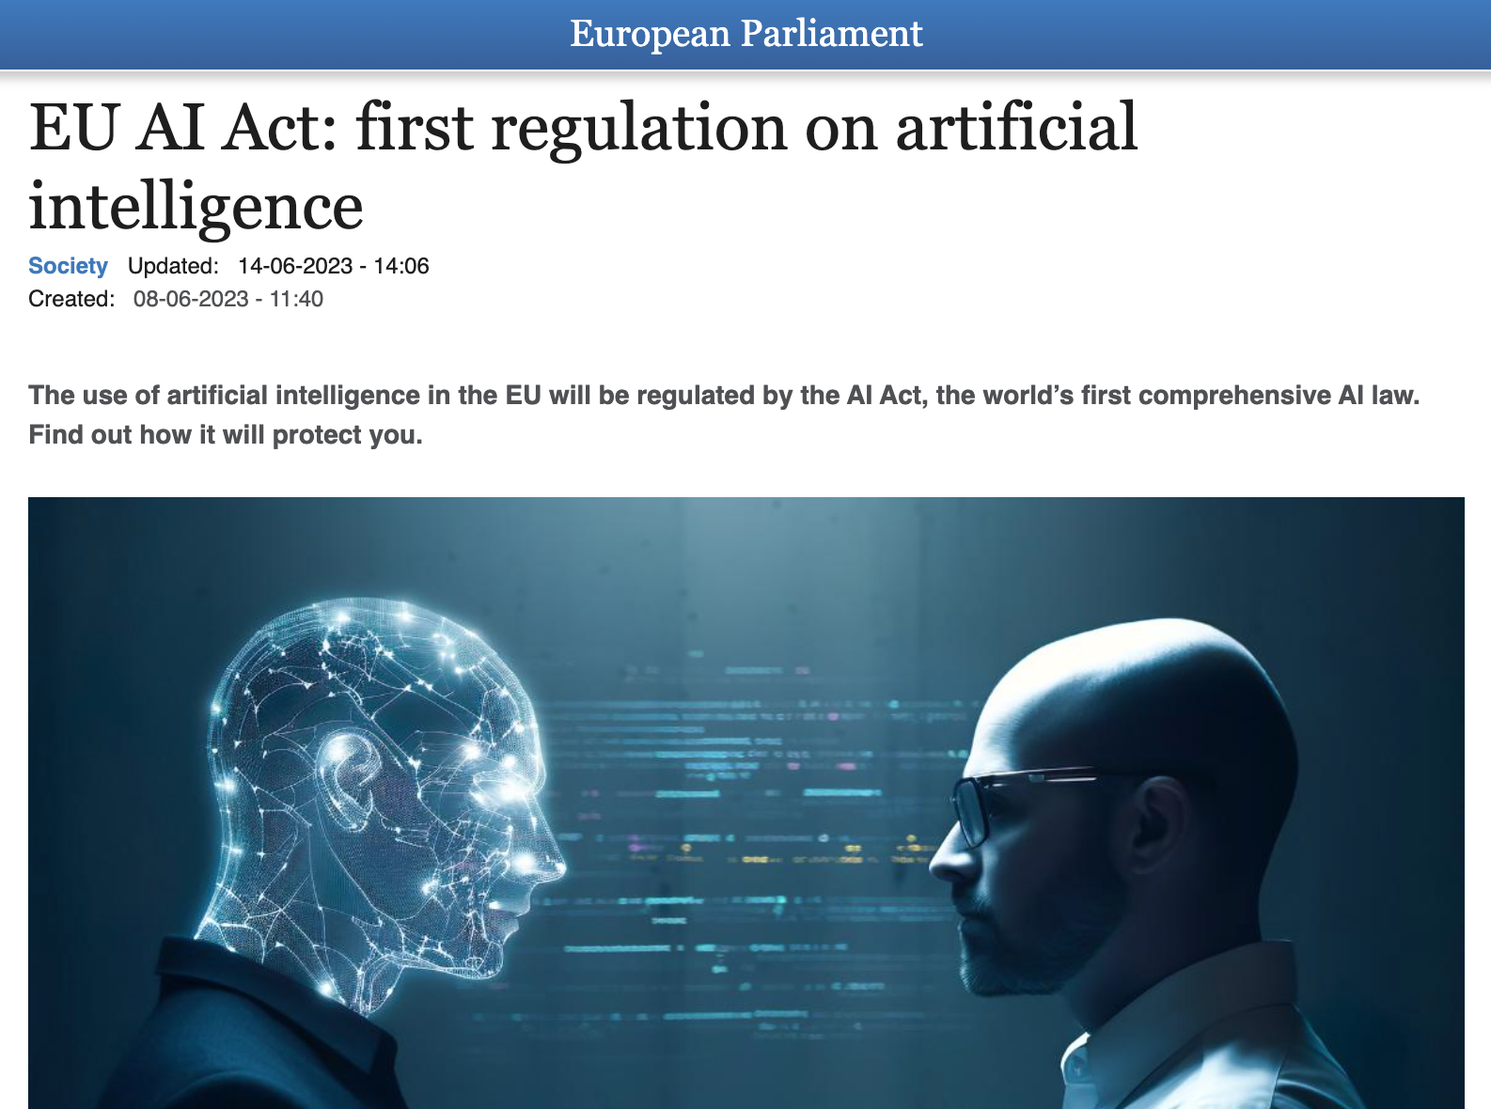

Regulation, frameworks, and standard operating procedures can help ensure responsible AI development.
Define problem and assess risk
Understand data readiness and model design
Develop and evaluate
A balance between regulation and guidance is needed for AI
Deploy
Notes:
A balance between regulation and oversight, guidance, or governance of AI to ensure ethical and responsible AI.

Slide 5




The equalised odds metric can be used to assess a model's fairness.
Sensitive attribute | Group | Equalised odds demonstrated
Sensitive attribute | Group | Initially | With threshold optimisation
Sex | Female | ✓ | -
 | Male | ✓ | -
Age | 20 | ✓ | ✕
 | 30 | ✓ | ✓
 | 40 | ✓ | ✓
 | 50 | ✓ | ✓
 | 60 | ✓ | ✓
 | 70 | ✓ | ✓
 | 80 | ✓ | ✓
 | 90 | ✕ | ✓
Race | Asian | ✓ | ✓
 | Black | ✓ | ✓
 | Hispanic | ✓ | ✓
 | Native | ✕ | ✕
 | Other | ✓ | ✓
 | Unknown | ✓ | ✓
 | White | ✓ | ✓
Insurance | Medicaid | ✕ | ✓
 | Medicare | ✓ | ✓
 | Other | ✓ | ✓
One key challenge is determining when to switch antibiotics from IV-to-oral administration

Slide 6
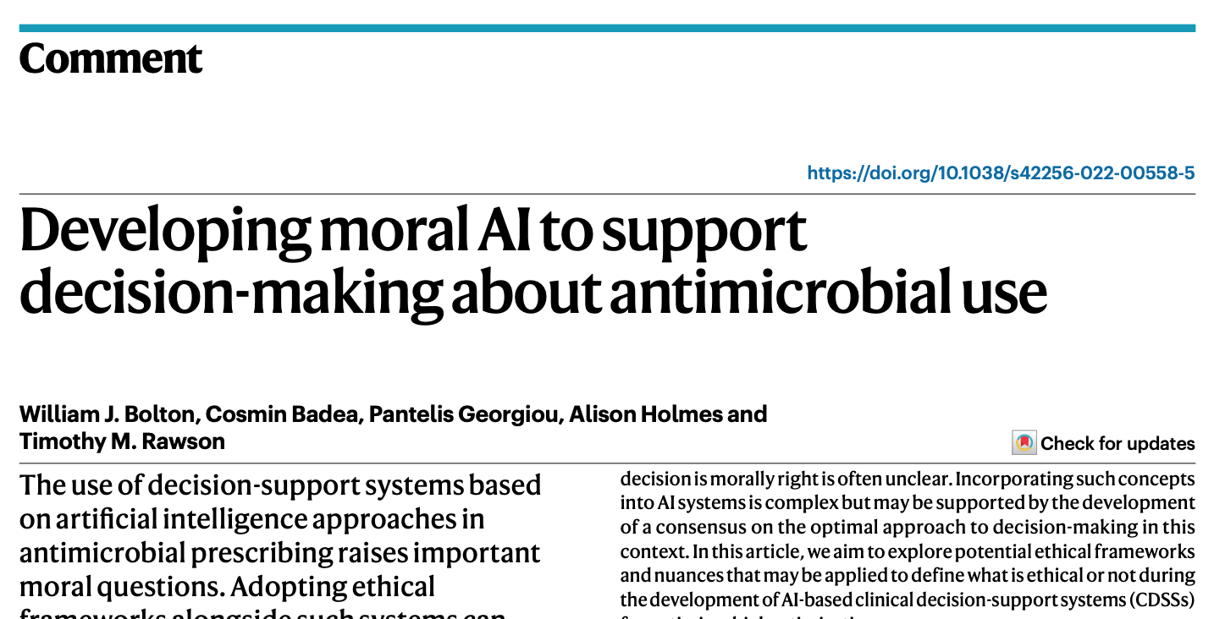


Ethical frameworks such as Bentham’s felicific calculus can help us work towards developing moral AI.
ETHICAL VIEWPOINT
Notes:
Regarding antimicrobial decision making, we believe a utilitarian approach is most suitable for developing AI-based CDSSs, and that technology should focus on the likelihood of drug effectiveness and that of resistance in order to have the biggest impact on supporting moral antimicrobial prescribing (Table. 1). Furthermore, for antimicrobials, spatial and temporal considerations are critical to optimise treatment outcomes and minimise the development of side effects or AMR. Decision making in antimicrobial prescribing is frequent, pressing, and both morally and technically complex. But by applying ethical theories to specific scenarios and incorporating moral paradigms, we can ensure that AI-based CDSSs tackle global problems, such as the emerging AMR crisis, in a moral way.

Slide 7
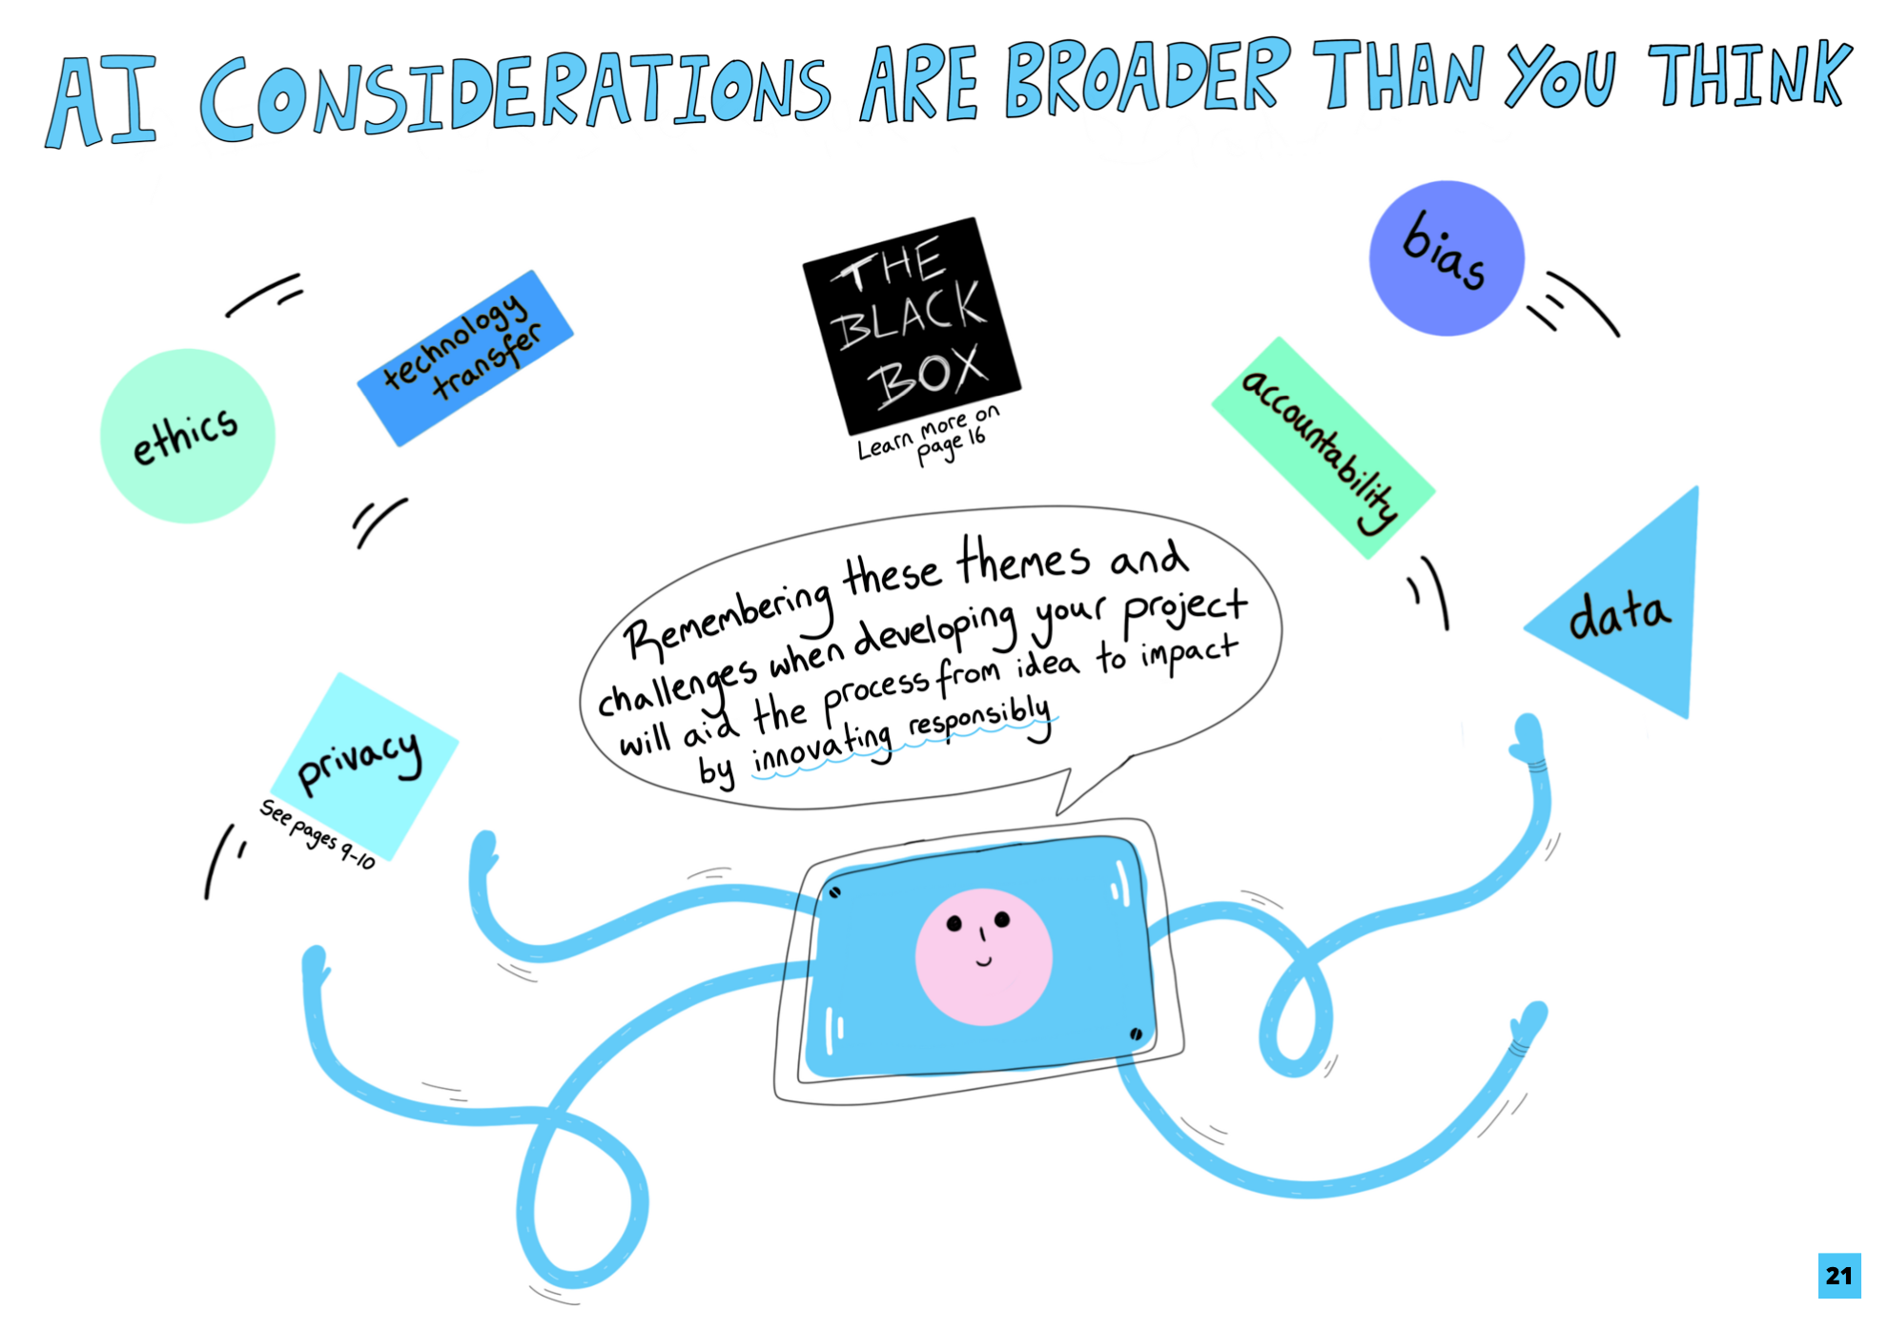
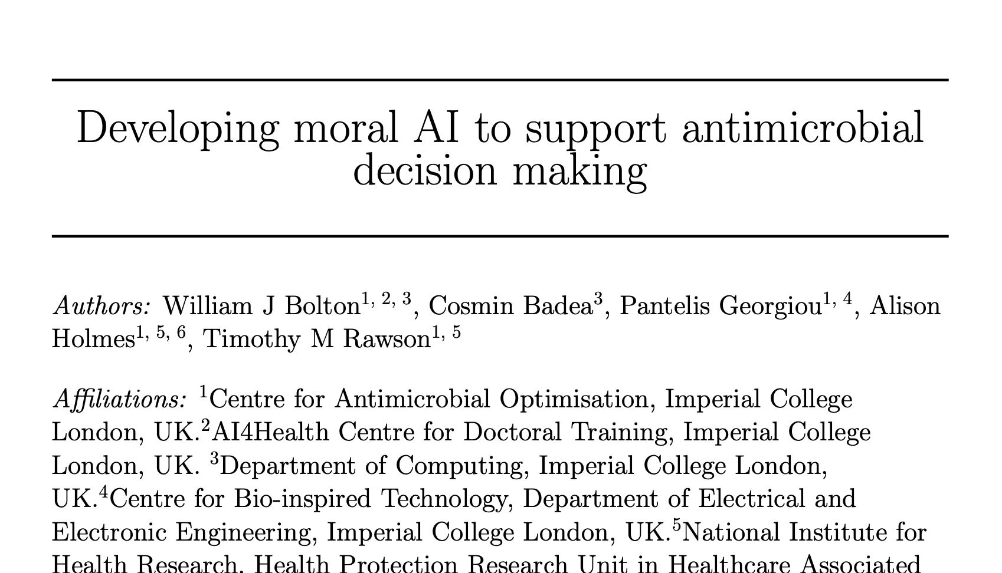
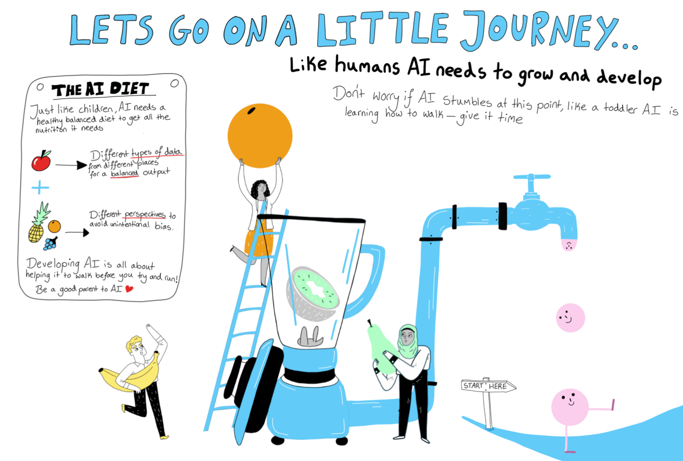

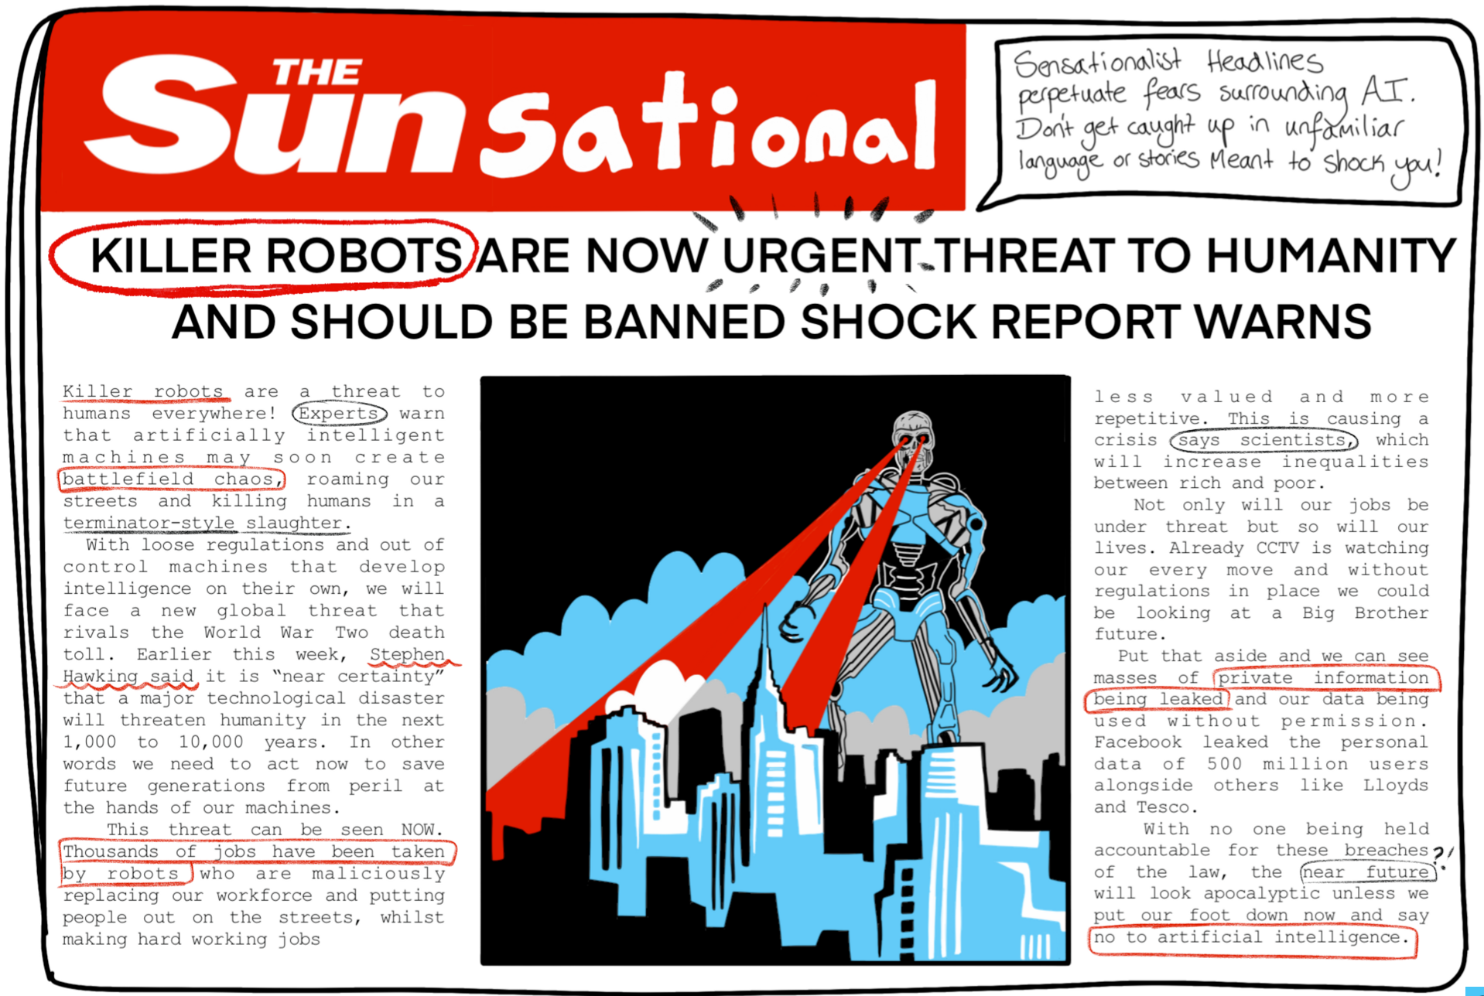

Education on the importance of responsible AI is essential.
PRIMARY RESEARCH

Slide 8
Education on the importance of responsible AI is essential.
PRIMARY RESEARCH

Slide 9
Education on the importance of responsible AI is essential.
PRIMARY RESEARCH

Slide 10




Thank you!
William Bolton
CAMO-NET 2023
15th December 2023
william.bolton@imperial.ac.uk

Slide 11
Developing Moral AI to Support Antimicrobial Decision Making.
Regarding antimicrobial decision making, we believe a utilitarian approach is most suitable for developing AI-based CDSSs, and that technology should focus on the likelihood of drug effectiveness and that of resistance in order to have the biggest impact on supporting moral antimicrobial prescribing (Table. 1). Furthermore, for antimicrobials, spatial and temporal considerations are critical to optimise treatment outcomes and minimise the development of side effects or AMR. Decision making in antimicrobial prescribing is frequent, pressing, and both morally and technically complex. But by applying ethical theories to specific scenarios and incorporating moral paradigms, we can ensure that AI-based CDSSs tackle global problems, such as the emerging AMR crisis, in a moral way.

